Slide 1
MACSE503: Enterprise Healthcare Data Platform
Sprint 0

Slide 2
Introduction
For smoother and more timely workflow of hospital operations, we propose an Enterprise Healthcare Data Platform (EHDP), an end-to-end data engineering initiative for multi-hospital data integrations.
This platform ingests, profiles, transforms, validates and stores healthcare data to deliver trusted datasets for analytics, reporting and executive decision-making.
The platform will be built over a 3-month Agile delivery cycle incremented as sprints.

Slide 3
To understand the healthcare ecosystem and design an enterprise health data platform that aggregates, prepares and encapsulates datasets from different aspects of health.
Business Objective

Slide 4
Technology Stack
Category | Technology
ETL | Pentaho Data Integration (Spoon)
Database | PostgreSQL
Programming | Python (Pandas)
Version Control | Git & GitHub
Reporting | Power BI
Documentation | Markdown/MS Word
Project Management | Agile Scrum

Slide 5
Project Scope
Develop source inventory and data dictionary (guide to all features)
Build ETL pipelines with Pentaho Data Integration (Spoon) to ingest, clean, validate and standardize data
The transformed data is staged in a PostgreSQL database server.
Every update is recorded in the project’s Git repository.
Full warehouse implementation, visualizations and star schema are not feasible for the scope of sprints 0 and 1 and will be deferred to sprints 2 and 3.

Slide 6
Project Charter
Objective: Design centralized enterprise healthcare data platform
Problem: Fragmented healthcare data
Dataset: Synthea Synthetic Healthcare Dataset – 15 tables (Patients, Encounters, Providers, Organizations, Conditions, Allergies, Observations, Procedures, Medications, Immunizations, Careplans, Imaging Studies, Devices, Payers, Payer Transitions)
Methodology: 3-month Agile Scrum

Slide 7
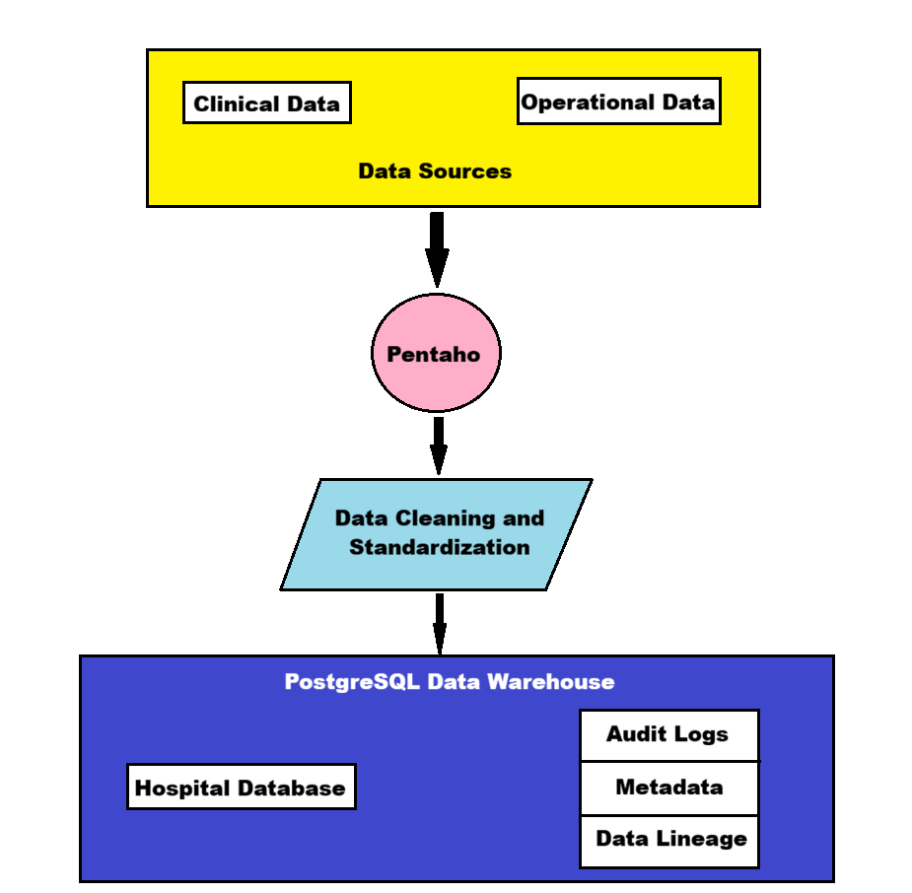
Architecture Diagram

Slide 8
We collect data from multiple fields in healthcare like patient records and operational history.
Pentaho Data Integration is used to ingest these data sources. With relevant transformations, the data is cleaned, validated and standardized.
The transformed data is loaded into a PostgreSQL server which serves as a data warehouse.
This data is maintained as a database for use in patient analytics, executive reports and hospital operations.
Metadata of the schemas, audit logs of database updates and data lineage are maintained in the same server, separate from the database.

Slide 9
Datasets
The platform’s database consists of 15 separate CSV files of healthcare data in a variety of fields from patient records to lab tests and insurance timelines.
There are relations between pairs of datasets (tables) enabled by foreign keys. For example, the Conditions table has a foreign key, the patient ID from Patients, that denotes who has the condition.

Slide 10
List of Datasets
Table | Description
Patients | descriptive, demographic, geographic and insurance data of patients
Conditions | Records of hospital visits, chief complaints, date and cost of visit
Allergies | Allergies documented in patients
Encounters | Appointments of patients to doctors at hospitals
Providers | Data of healthcare practitioners
Organizations | Geographics and financials of hospitals
Procedures | Treatments for each appointment
Medications | Medicines prescribed in an encounter
Imaging Studies | Description of diagnostic medical scans
Observations | Records of medical lab tests
Devices | Technology used in appointments
Immunizations | Vaccines taken by patients
Careplans | Management plans
Payers | Insurance providers with financials
Payer Transitions | Patient ownership of insurance deals

Slide 11
Thank You

Slide 12
Credits
Business Requirements Document (BRD) – Harish G.
Solution Architecture – Smrithi Rajan
Git Repository – Harish G.
Project Charter – Febi Sarju
Sprint Backlog – Febi Sarju
Presentation – Smrithi Rajan

